Slide 1

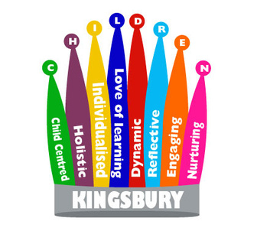



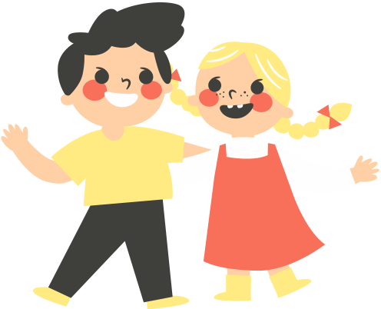

rshe: masturbation
How should we respond to sexual exploration?
Katie GM 2024

Slide 2


addressing challenging topics in a sensitive way
what is masturbation?
Masturbation is when a person touches their own genitals to give themselves sexual pleasure.
Masturbation is when a person touches their genitals in a way that feels nice for them.
how should we feel about it?
We are allowed to touch our own body in a way that feels nice for us when we are in private.
We are allowed to touch all parts of our own body in private.
Katie GM 2024

Slide 3
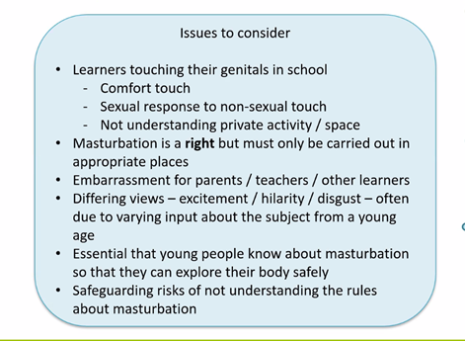

How should we respond when a pupil begins to masturbate or touch their genitals / rub them on furniture in school?
Is it inappropriate to teach pupils about masturbation and will it encourage them to do it more?
In primary schools, this can be delivered by focusing on boundaries, privacy, and children’s rights over their own bodies (DfE 2024. pg 17)
Katie GM 2024

Slide 4
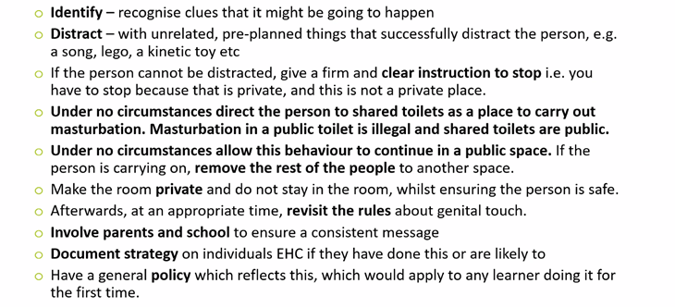
masturbation in non-private places
Katie GM 2024

Slide 5
Private parts in private places!
Katie GM 2024

Slide 6
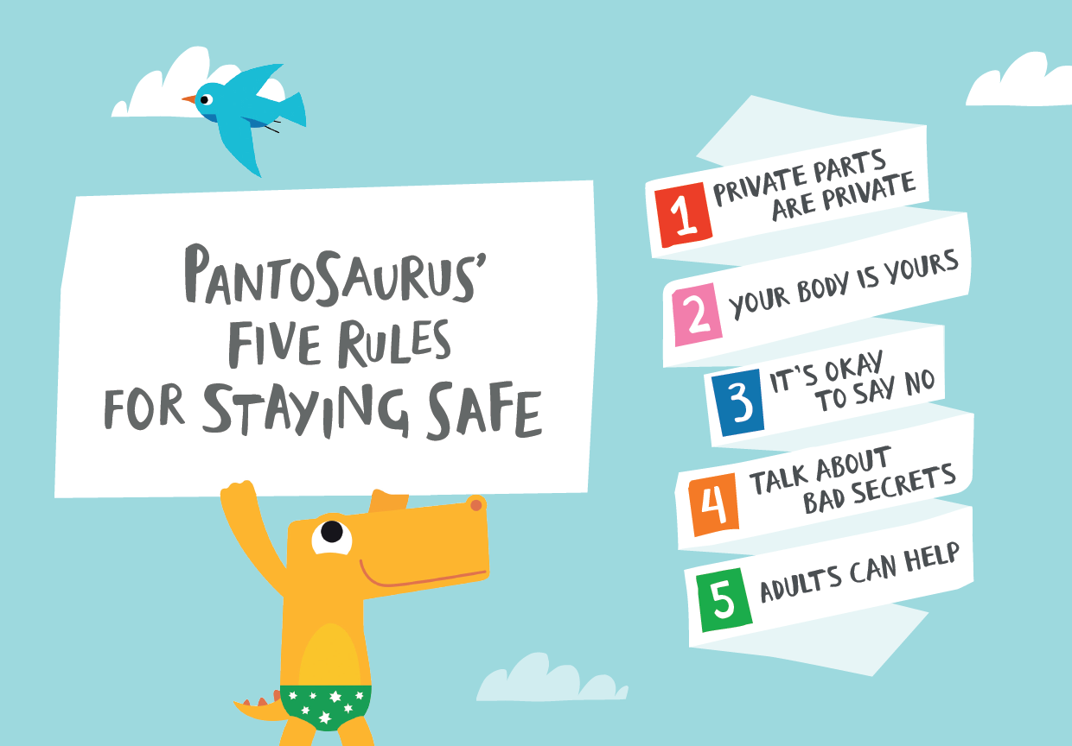
Katie GM 2024

Slide 7
using social stories
How do social stories help?
Social stories present information in a literal, 'concrete' way, which may improve a person's understanding of a previously difficult or ambiguous situation or activity. The presentation and content can be adapted to meet different people's needs.
  Picture the goal
Consider the social story's purpose.
Now think about what the child needs to understand to achieve this goal.
3.Tailor the text
A social story needs to have a title, introduction, body and conclusion. It should use gentle and supportive language.
It should answer six questions: where, when, who, what, how and why?
It should be made up of descriptive sentences, and may also have coaching sentences. A descriptive sentence accurately describes the context, whereas a coaching sentence gently guides behaviour.
2.Gather information
Collect information about the situation you want to describe in your social story. Where does the situation occur? Who is it with? How does it begin and end? How long does it last? What actually happens in the situation and why? If it is for a situation where a particular outcome is not guaranteed, use words like ‘sometimes’ and ‘usually’ in the story.
Katie GM 2024

Slide 8
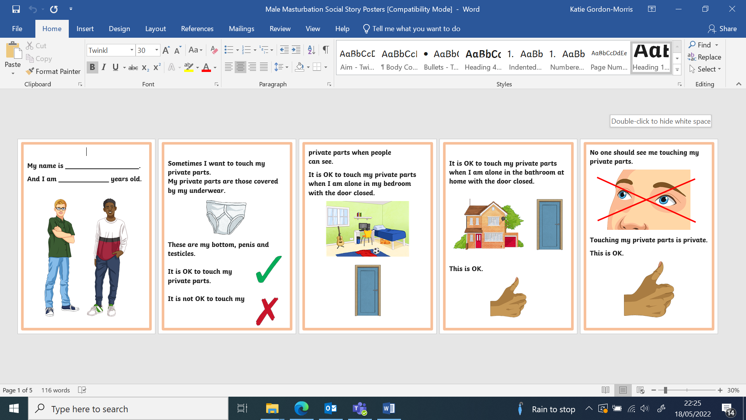
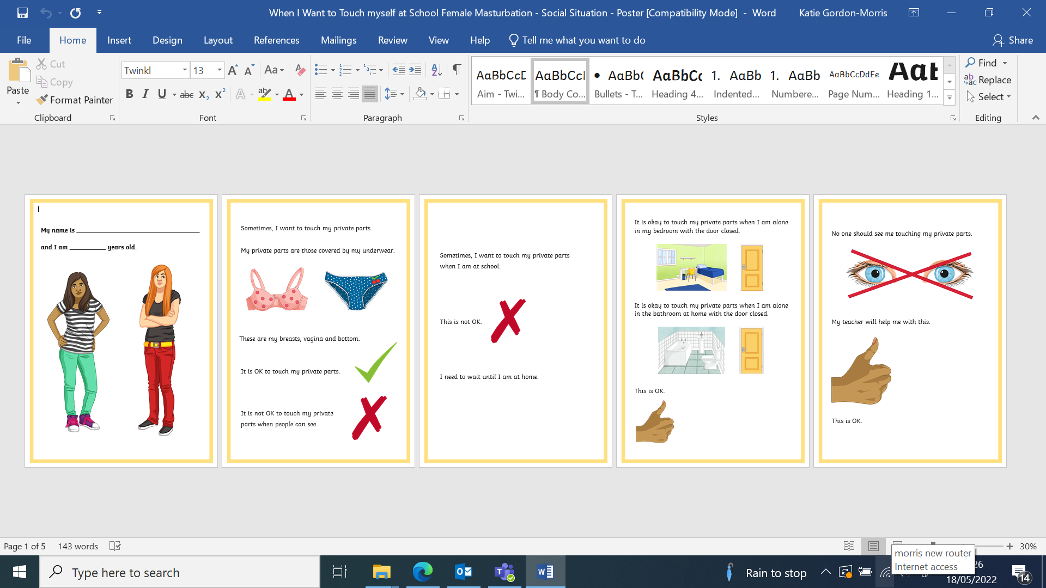
Katie GM 2024

Slide 9

what can i say?
Masturbation is healthy and safe. There are lots of benefits such as stress relief and sensory experience.
Masturbation is allowed. It is normal. Most people do it sometimes.
You may only masturbate in private.
Masturbation may be uncomfortable if you do it for too long, or do it to roughly. You may make your genitals sore.
Masturbation is private. You may only do it in a safe private place where you won't be disturbed.
Katie GM 2024

Slide 10
Resources and references
  Draft RSHE statutory guidance (DfE 2024)
  Social stories and comic strip conversations (autism.org.uk)
  Masturbation - HealthyChildren.org
  9 Top Masturbation Teaching Resources (twinkl.co.uk)
  5 ways to get ready for statutory RSE | sexeducationforum.org.uk
  RSE for disabled pupils and pupils with SEN - SEF.pdf (sexeducationforum.org.uk)
Katie GM 2024

